Slide 1



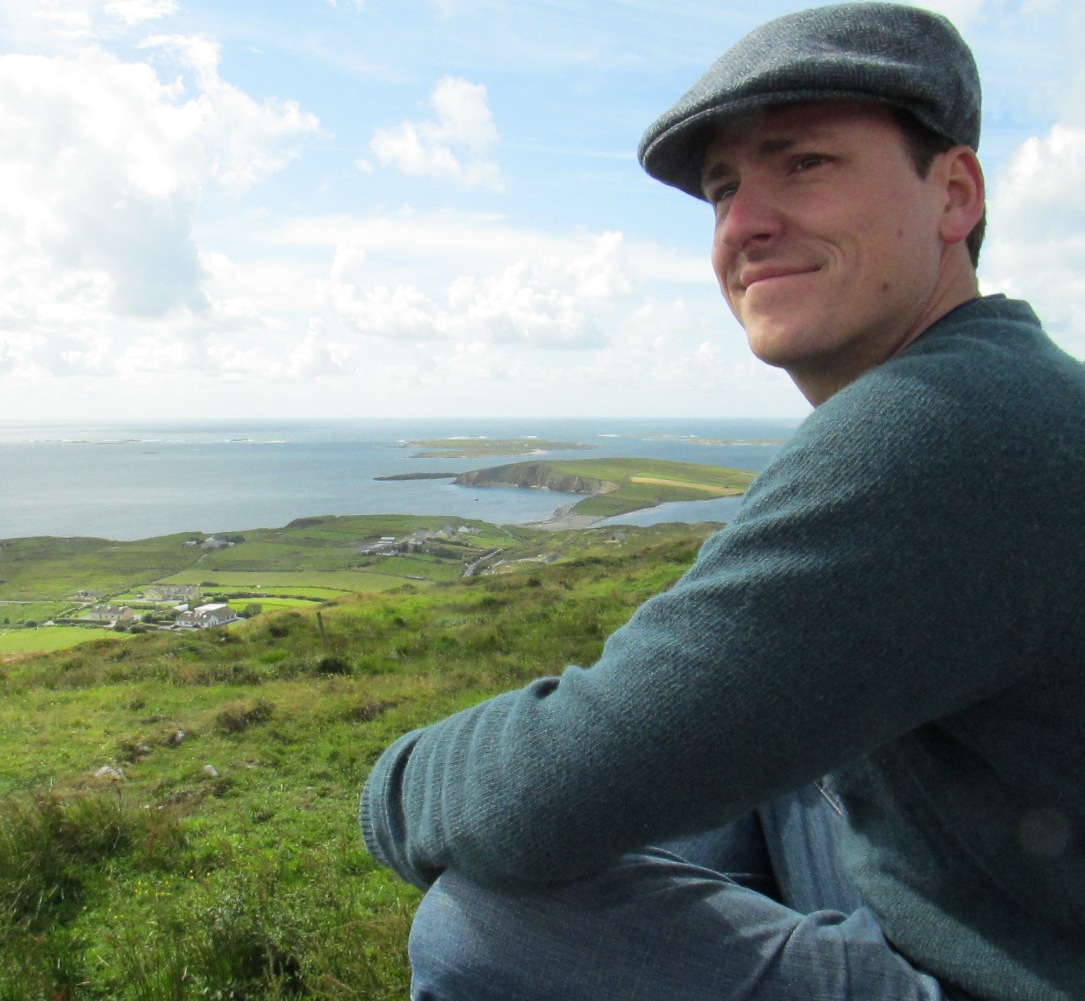
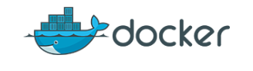

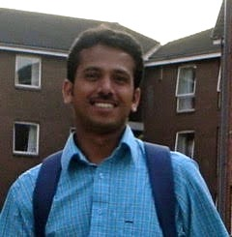
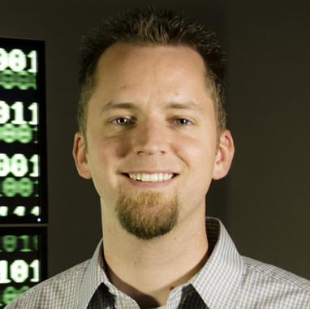
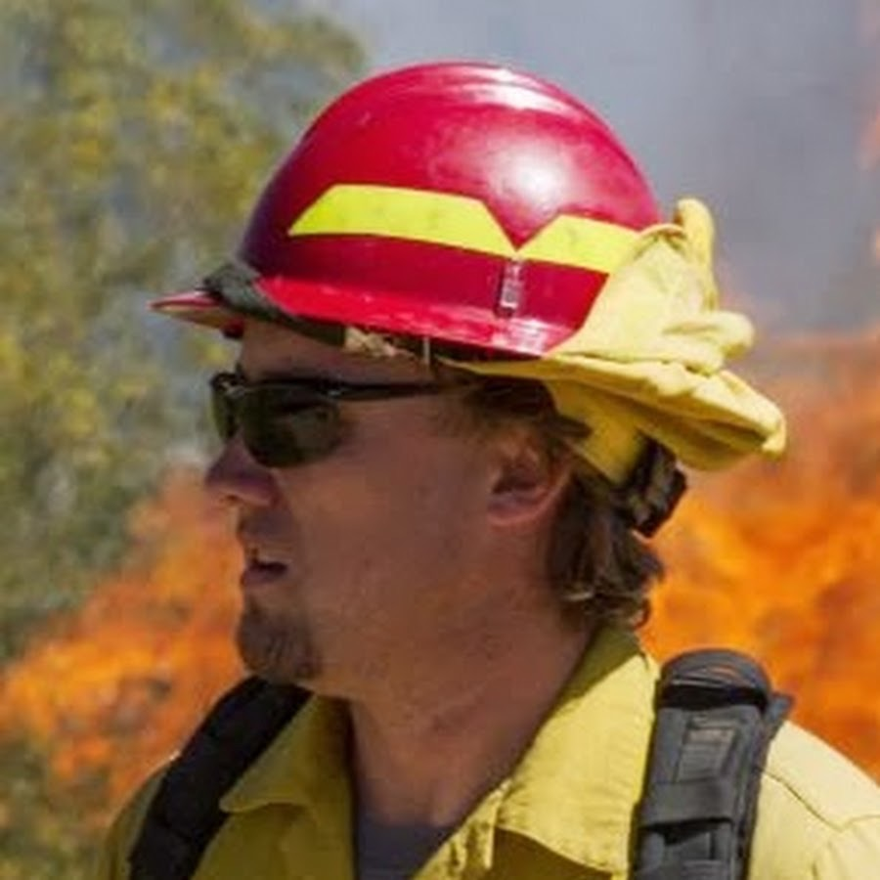
Journey to the Compute
Day 1: Containers to Quiet the Dependency Hells
By Blake Joyce
Blatantly copied, smashed together, melted down, and reforged from efforts by:
Upendra Devisetty
John Fonner
Tyson Swetnam

Slide 2
What We Are Really Interested In
Larger compute resources
Accomplish tasks not feasible on local
Accomplish tasks faster
Always be lazy! Laziness is directly responsible for civilization (more on this later)
Data-driven decision making expedited
Cheaper (free!?) resources
Single time use of specialty resources (GPUs, etc)
Off hour consumption is really cheap
Basically this translates as: HPC or Cloud

Slide 4
Setting Expectations of This Workshop
We’re focusing on intro abilities
CyVerse
Medium scale compute
Democratization of analyses (GUIs)
Walk in the door registration
Development environment
TACC and XSEDE
Big compute
Command line interfaces
XSEDE requires allocations

Slide 5
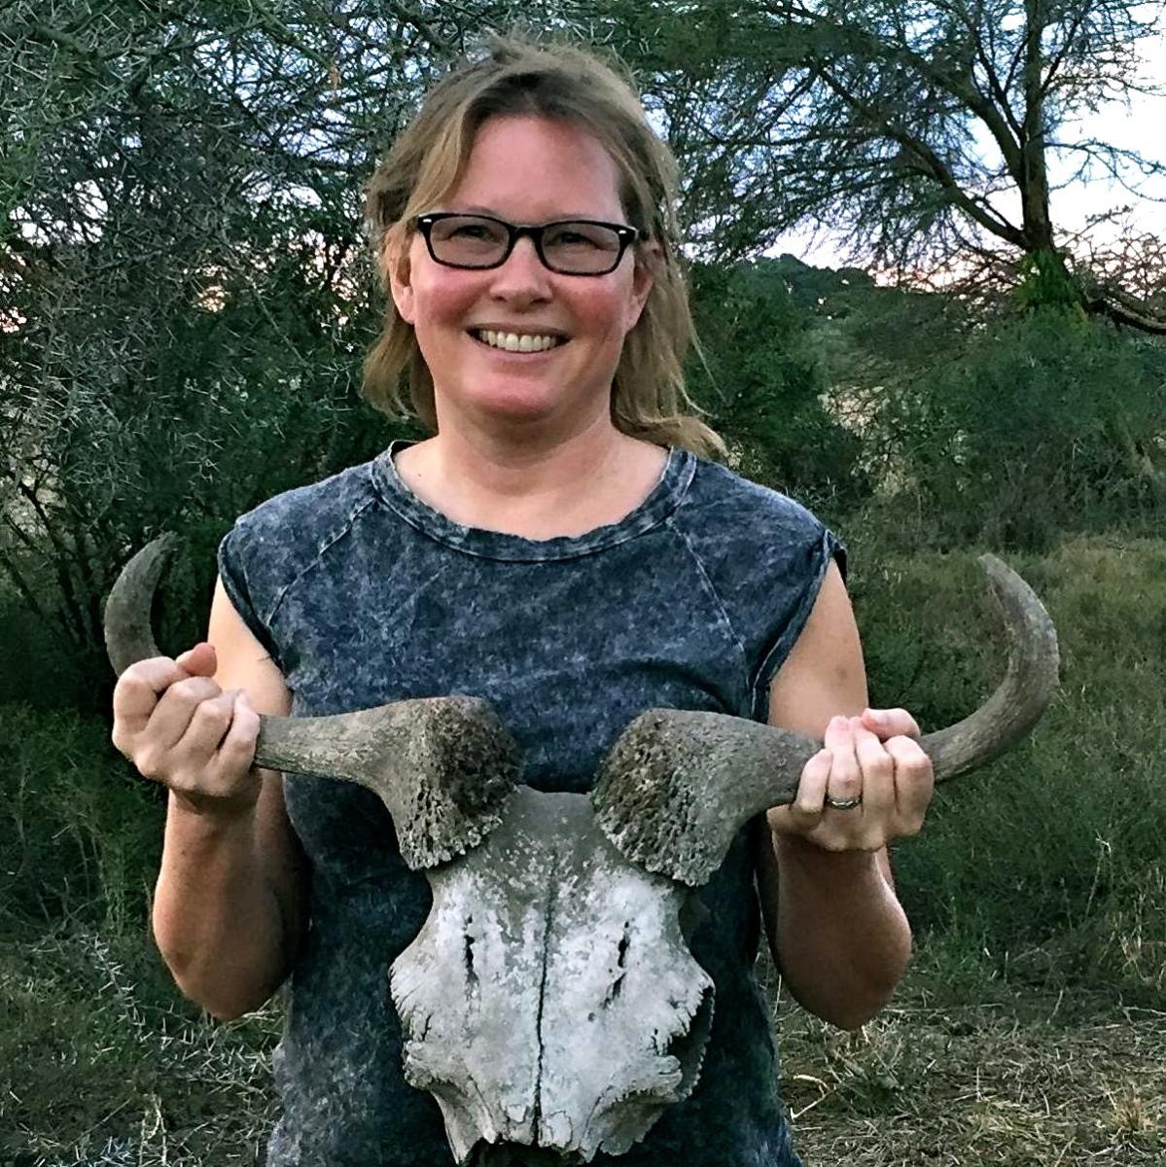
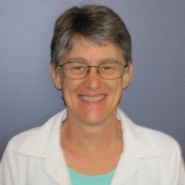
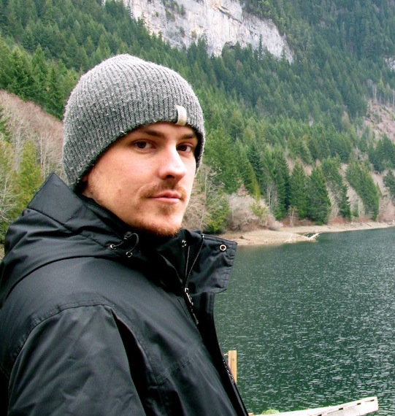
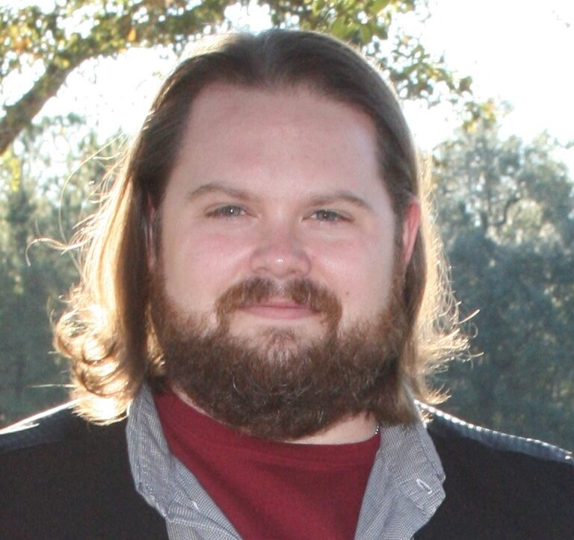
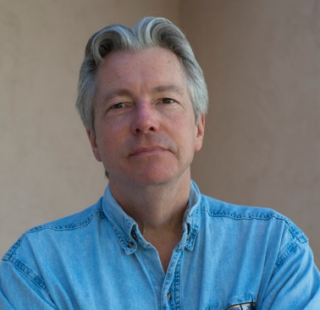
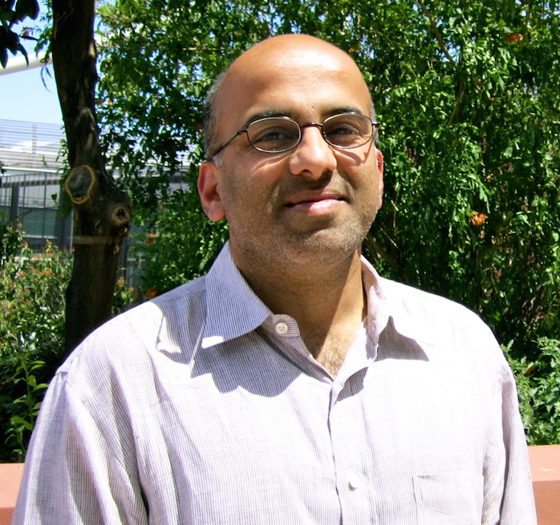

Who We Are: the SI Team
Ramona Walls
4 years
14 proposals
5 grants
14 publications
Ecology
Ontologies
Data Standards
Data Identifiers
Data Commons
Upendra Devisetty
9 months
3 publications
Genomics
Metagenomics
Transcriptomics
Docker Genius
Martha Narro
8 years
3 proposals
3 publications
Image Management and Analysis
Project Management
Tyson Swetnam
Aug 2016
1 proposal
4 grants (continuing)
2 publications
GIS/drones
Remote sensing
Blake Joyce
Aug 2016
1 proposal
3 publications
Agriculture
Ecology
Software Carpentry
Hacky Hour
Past Science Informaticians

Slide 6
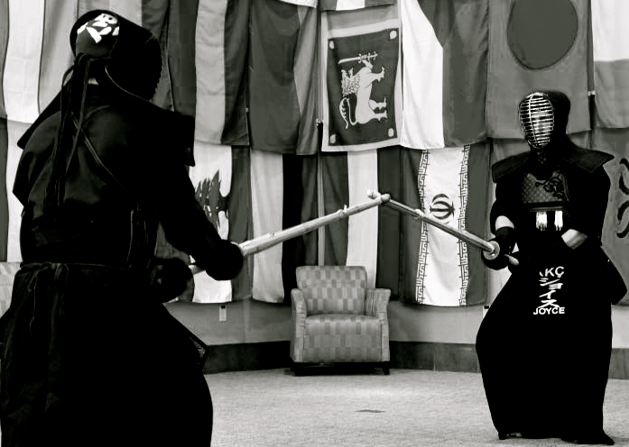
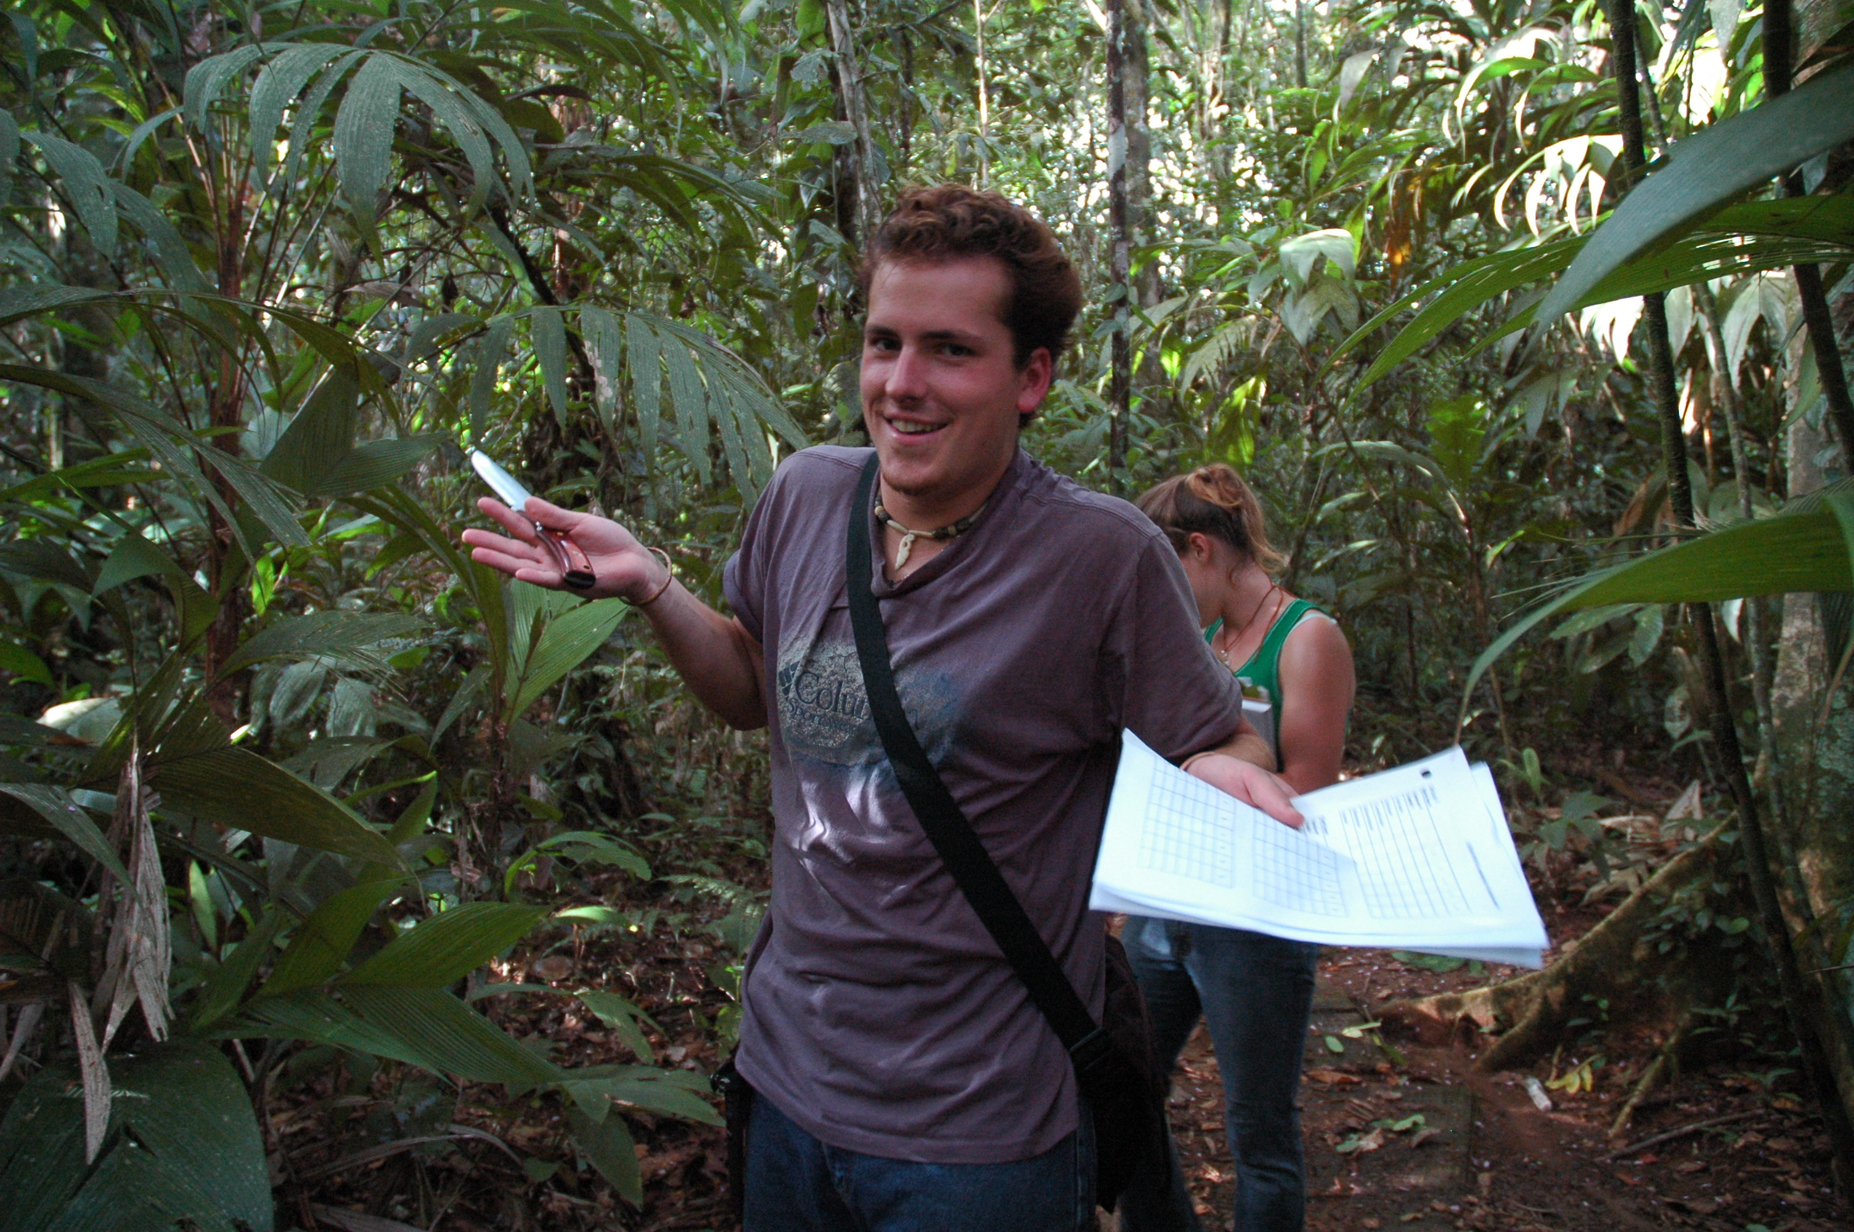
Setting Your Expectations of Me
I am a life scientist
Postdoc at CoGe
(dubbed ‘the code curious biologist’)
PhD in Plants, Soils, and Insects
Master’s in Plant Molecular Biology
Bachelor’s in Ecology; another in Biology
I am fairly irreverent and prefer humor
Though I can be serious (Figure 1)
Mostly I’m not (Figure 2)
I’m told it’s a Gambit-like charm
I am pragmatic to a fault
These lessons will be overly simple
If you have questions ask at any time
If you have personally specific questions: save them for happy hour

Slide 7

Speaking of Happy Hour…
There’s also
Shut Up & Write
Fridays
8:00-10:00
UA iSpace
Science & Engineering Library

Slide 8
Here’s the Tools We Need
Docker
Containerized software and dependencies
Runs a Docker daemon and requires root access
Simplistically: containers = light virtual machines
Singularity
Not just ‘Docker for HPC’
Doesn’t allow root access
Circumvents the ‘request to install’ on HPCs

Slide 9
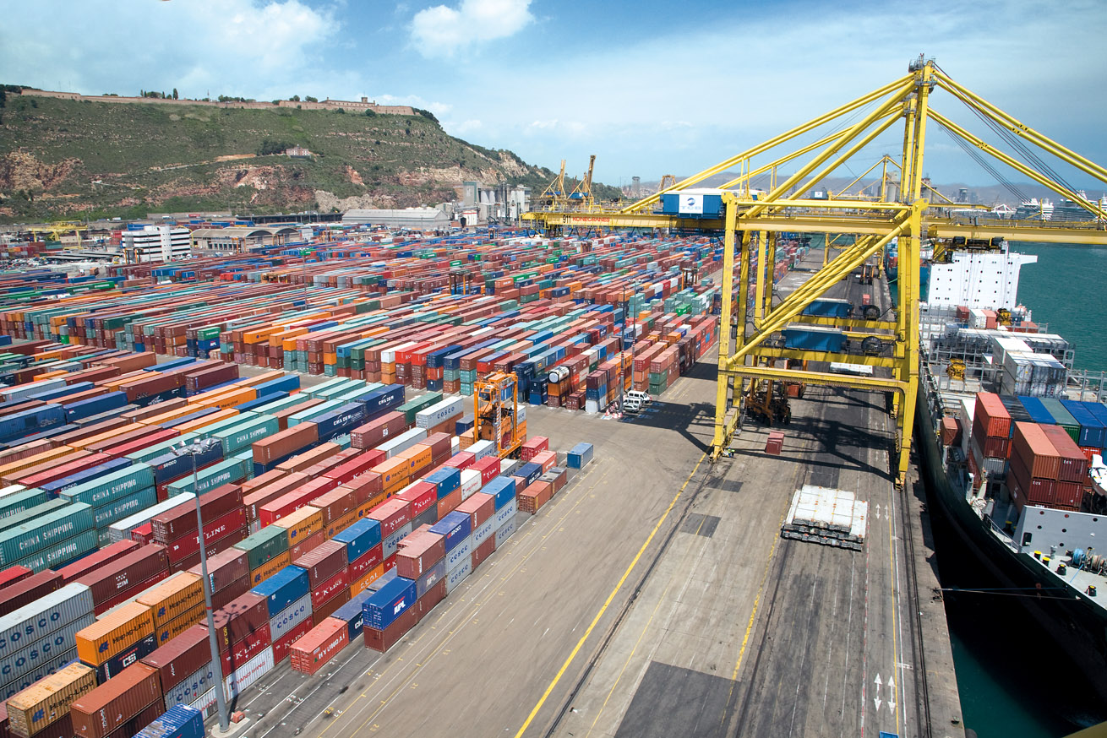
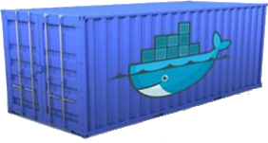
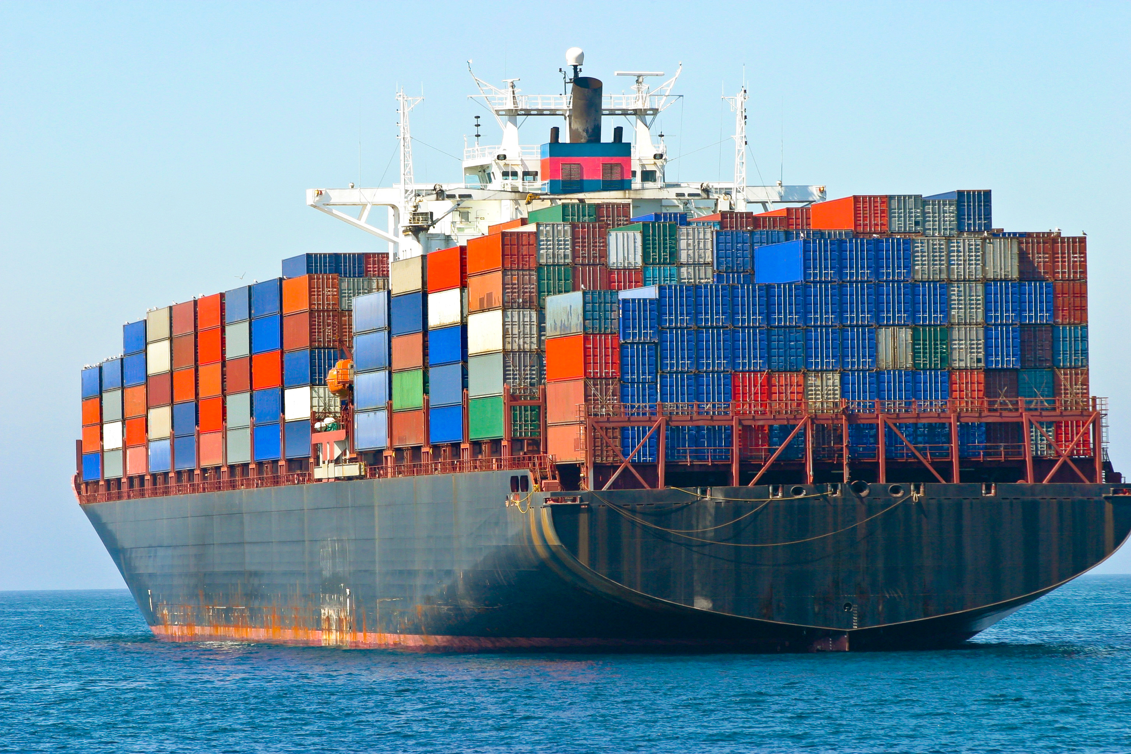
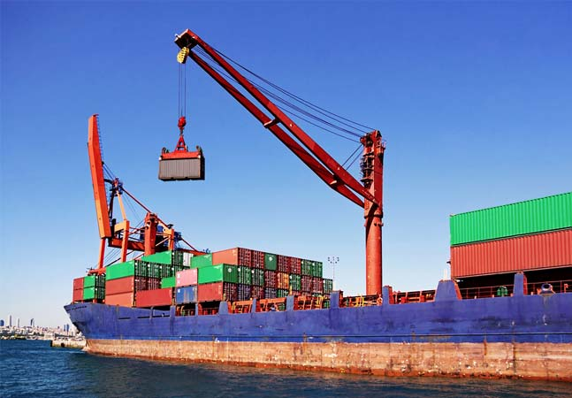
Uh Wait, What’s All This About Containers
Fill the Container
“DockerHub”
Science! Or Analysis! Or Whatever!
Setting up Compute (VM or HPC node)
Notes:
Supplier -> Consumer
Shipping containers are a standard height and width
Everyone has agreed to that standard!
One unit of impossible social engineering

Slide 10
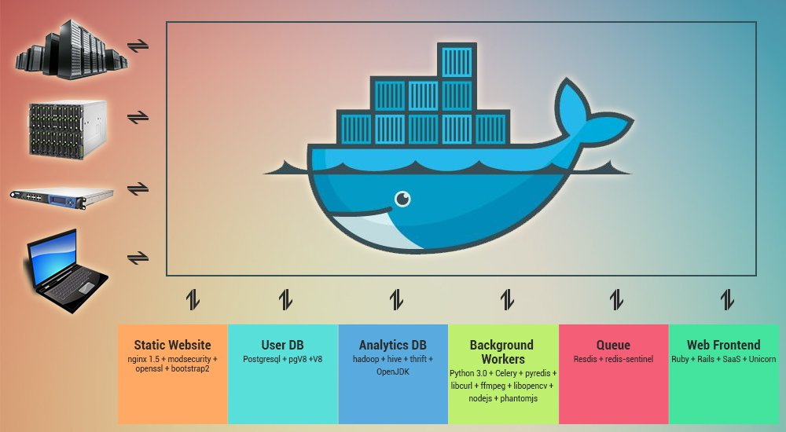
Uh Wait, So Who Cares?
From: https://www.openxcell.com/containerize-your-startup-with-docker

Slide 11
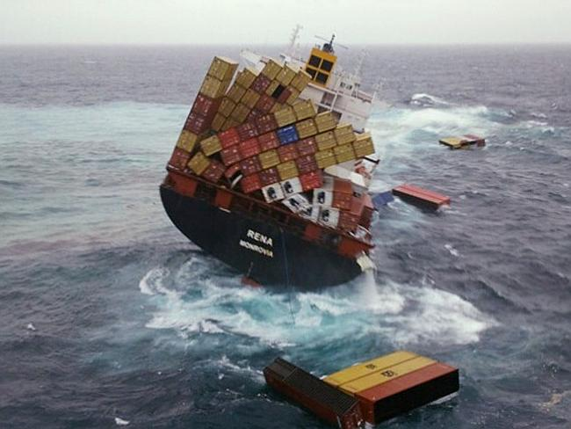
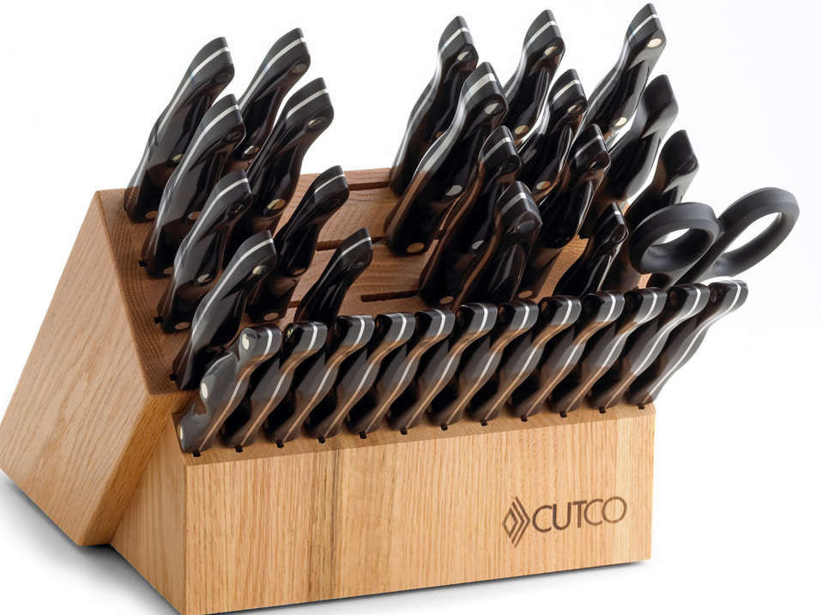
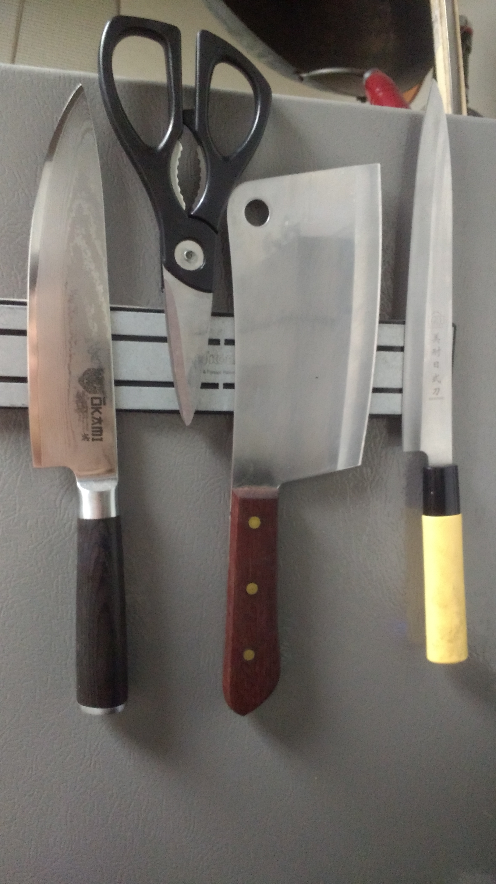
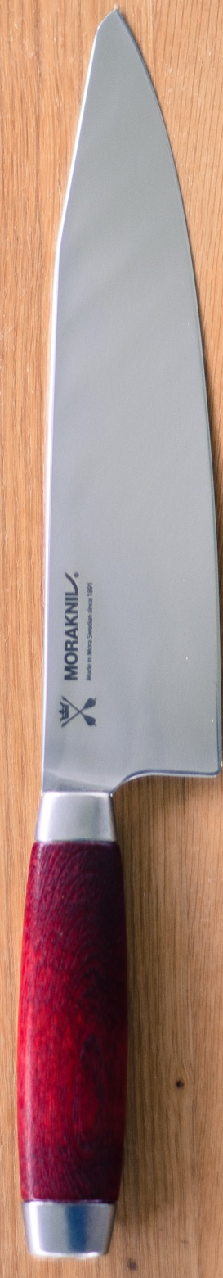
Of course at crazy (enterprise) scales you get this
But that’s to be expected and I’ll say it’s early days yet (Docker started 2013)
I follow the philosophy of the middle path
In this case: use the right tool(s) for the right job
Mostly worthless
My personal suggestion
Dubious

Slide 12
Here’s Our Path to the Compute
Let’s speak in practical terms about our workflow
Day 1
Intro to Docker
Preparing containers
Perhaps Singularity?
Goal: get a container you can use next time
Day 2
Docker to Cloud
Docker -> Singularity -> HPC
You figure out the compute resources
All the slides presented will be available to you after the webinar.

Slide 13
Using Ready Made Containers
Pull pre-built containers from DockerHub
Pull a base container and use that (DockerHub)
Test Docker: Go for it!
Test the waters:
`docker run hello-world`

Slide 14
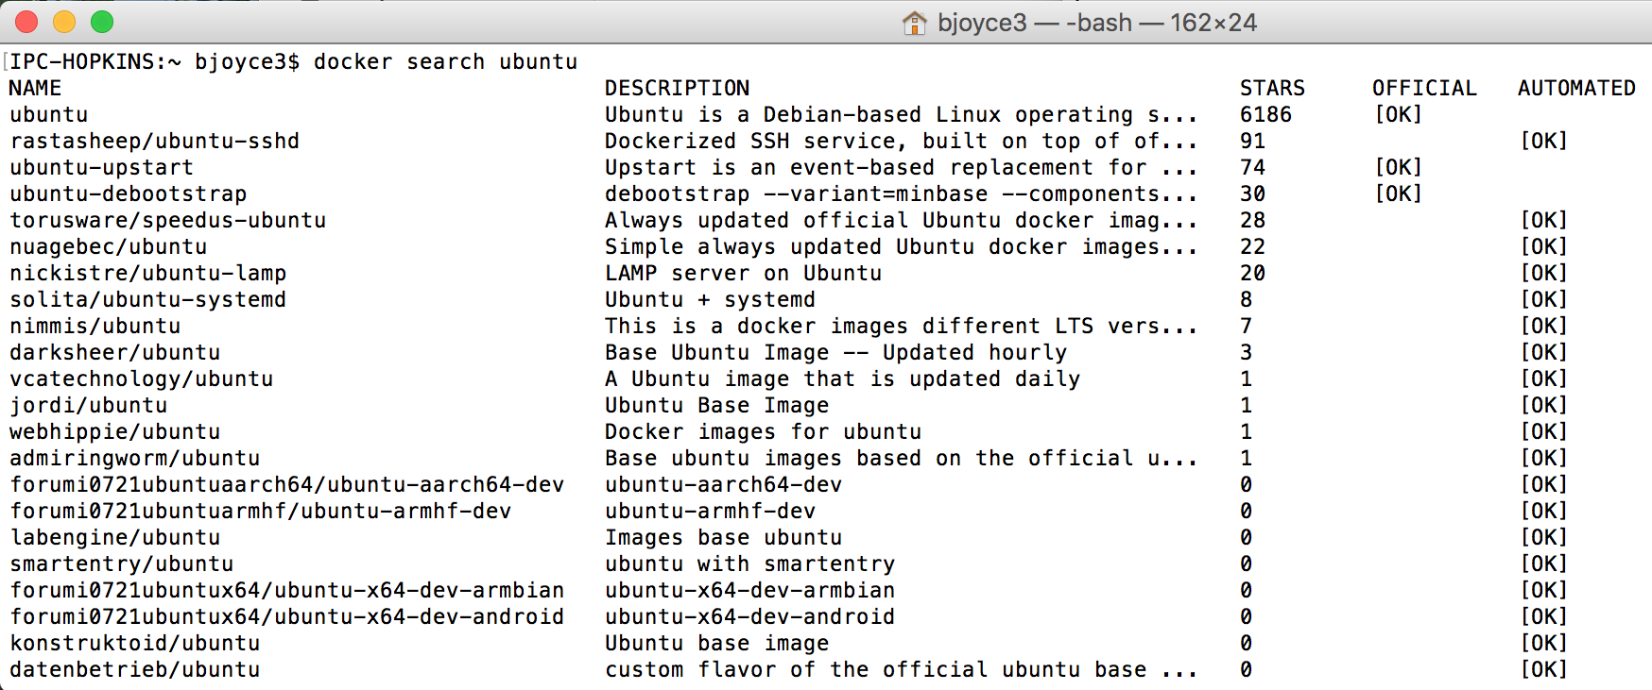
Search DockerHub: Try it out!
Use command line:
`docker search ubuntu`
User DockerHub website: https://hub.docker.com/

Slide 15
Pulling Docker Container
For base OS, try the ‘Official Repository’
https://docs.docker.com/docker-hub/official_repos/
Once you find something you like, pull it to your local
`docker pull ubuntu`
NOTE: you can specify versions
`docker pull ubuntu:16.10`

Slide 16
Running Docker Containers
This is what we did before
`docker run hello-world`
Find your own interesting container
Try dropping some data in there or installing something else (note: it’s better to add installs to dockerfile)
`docker run [image name]`

Slide 17
Scaling Up: CyVerse Discovery Environment
Docker Runs Software Here

Slide 18
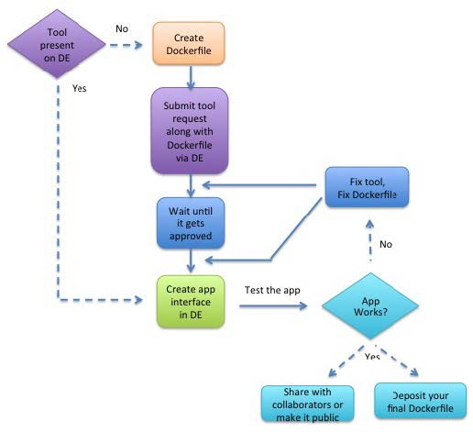
Figure 2. CyVerse App Integration.
From Devisetty 2016
http://dx.doi.org/10.12688/f1000research.8935.3
Pull from DockerHub

Slide 19
Adding a Tool to CyVerse
Test it locally! (Example below; assumes an entrypoint)
Input data is in a scratch directory
Working directory set with `-w` flag
Environmental variables can be passed with `-e` flag
`docker run --rm -v ~/my-scratch-dir:/working-dir
-w /working-dir
your/docker-image
user-input-1 user-input-2`

Slide 20
1
2
3

Slide 21
Example: Start with a Dockerfile
Derive the tool from an official Docker image (e.g., ubuntu:14.04.3 for the operating system)
Example Dockerfile from Devisetty 2017
`FROM ubuntu:14.04.3
MAINTAINER Kapeel Chougule
LABEL Description="This image is used for running Kallisto RNA seq quantification tool"
RUN apt-get update && apt-get install -y build-essential cmake zlib1g-dev libhdf5-dev
RUN apt-get install --yes git
RUN git clone https://github.com/pachterlab/kallisto.git \
&& cd kallisto \
&& git checkout 5c5ee8a45d6afce65adf4ab18048b40d527fcf5c \
&& mkdir build \
&& cd build \
&& cmake .. \
&& make \
&& make install
ENTRYPOINT ["kallisto"]`
`docker build -t"=ubuntu/kallisto”`
docker run --rm -v /Users/bjoyce3/Downloads:/kallisto_data -w kallisto_dataubuntu/kallisto kallisto index -i transcripts.idx transcripts.fasta.gz

Slide 22
Building Your Own: CyVerse Best Practices
Include all installation steps in the Dockerfile
Example: a Dockerfile should not copy and run a script that
APT commands should be in the Dockerfile
Write the Dockerfile to fail fast
If anything goes wrong, construction of the image will fail
The Docker image will not be deployed
Encapsulate the tool execution to avoid external dependencies unless by design (e.g., tool provides integration with external service)
Use entrypoints!
(http://goinbigdata.com/docker-run-vs-cmd-vs-entrypoint/)
Reproducibility is very important!

Slide 23
Limitations by Platforms
Windows
First of all, if you’re reading this: shame on you. Coding on a Windows box!
Docker is available
Singularity is not (so no HPC)
Mac
All good. This workflow was created on a Mac

Slide 24
Limitations by Your Job Title
Industry
No access to XSEDE/UA HPC/CyVerse without prior discussion
Government
Budgetary terror every 4 years
No UA HPC
Academics
Salary and work/life balance
But no limitations with this workflow (developed by academics)

Slide 25
Homework
Look at singularity2docker
https://github.com/singularityware/docker2singularity
Download Singularity
http://singularity.lbl.gov/
Windows folks:
You’ll need a virtual environment
Or access to a non-Windows OS (preferably Linux)
Windows == Double homework

Slide 33
Run an App in the Discovery Environment

Slide 34
Run an App in the Discovery Environment

Slide 35
Run an App in the Discovery Environment

Slide 36
Run an App in the Discovery Environment

Slide 37
Docker Can Run Software in Atmosphere, too

Slide 39
Docker glossary
Docker image: Ready snapshot of a configured software application.
Docker container: Instance of a Docker image.
Dockerfile: Set of instructions/commands that are used to build the Docker image.
Using Docker in the CyVerse DE
CyVerse has adopted Docker for integrating software apps that run in the CyVerse DE’s Compute Cluster (Condor). The user creates a Dockerfile, which is used to build the Docker image containing the tool that will be used as an app in the DE.

